Slide 1
FINANCIAL RISK ANALYSIS
Data preprocessing, risk categorization & feature selection
INFOSYS-DATA VIS INTERNSHIP
MILESTONE-02
Presented by: Praharsha
Sindhura
Madeeha
Santhosh
Financial Risk Analysis | Data Science Project

Slide 2
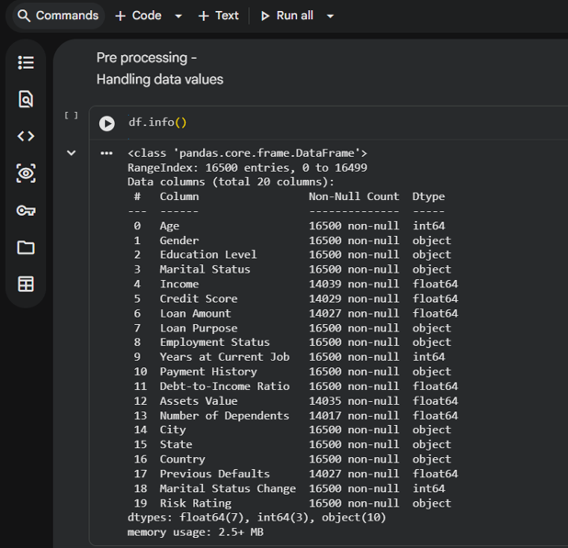
01 DATA PREPARATION
2
Dataset Inspection & Initial Data Understanding
The notebook begins by checking the structure, size and data types of the financial dataset.
• The dataset contains 16,500 records across 20 columns.
• Financial variables include income, credit score, loan amount, assets and debt-to-income ratio.
• Categorical fields include gender, education, employment, payment history and risk rating.
• Missing values are visible in several numeric fields and must be handled before analysis.
df.info() — 16,500 records and 20 original columns

Slide 3
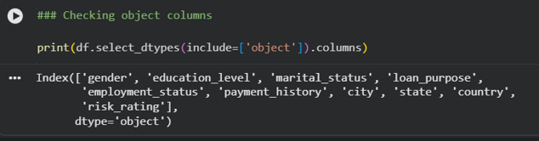
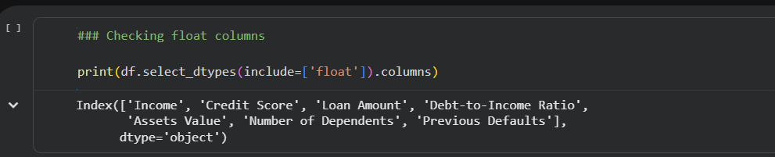
02 DATA QUALITY
3
Identifying Numeric & Categorical Variables
Columns are separated by datatype so each group can be processed correctly.
Numeric / float columns
Categorical / object columns
Numeric variables
Income, credit score, loan amount, DTI, assets, dependents and previous defaults.
Categorical variables
Gender, education, marital status, loan purpose, employment, payment history and risk rating.
Why this matters
Different data types require different cleaning, transformation and encoding methods.
• Separating the columns prevents inappropriate transformations.
• It also prepares the dataset for later feature engineering and machine-learning steps.

Slide 4
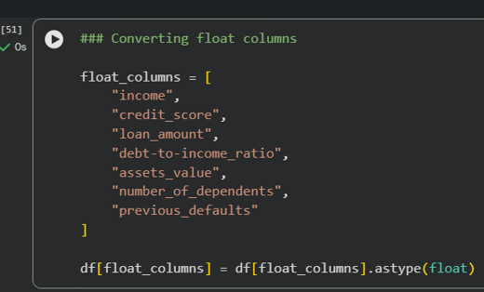
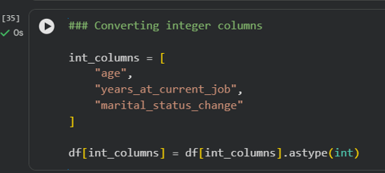
03 TYPE CONVERSION
4
Converting Columns to Consistent Data Types
Explicit type conversion ensures reliable mathematical operations and model inputs.
Integer columns converted using astype(int)
Financial numeric columns converted using astype(float)
• Age, years at current job and marital-status change are stored as integers.
• Income, credit score, loan amount, DTI, assets, dependents and previous defaults are treated as numeric values.
• Consistent types reduce calculation errors and make downstream analysis more dependable.

Slide 5
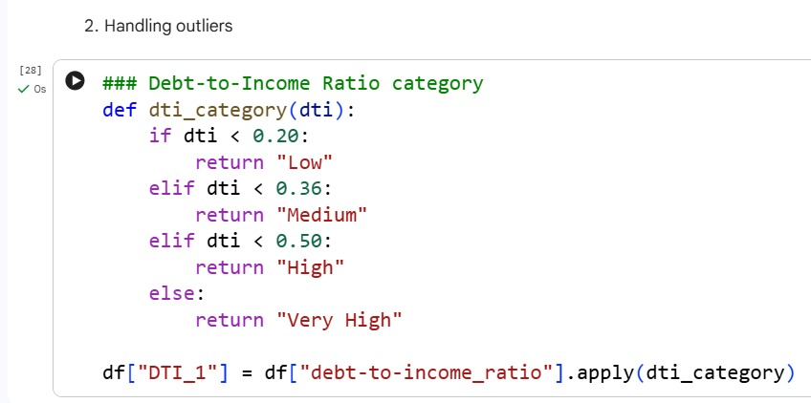
04 RISK CATEGORIZATION
5
Creating Risk-Oriented Categories
Continuous financial variables are transformed into meaningful bands for easier interpretation.
• Income and loan size are divided into Low, Medium, High and Very High groups.
• Credit score is grouped from Poor to Excellent.
• DTI is grouped by increasing debt burden, making financial stress easier to compare.

Slide 6
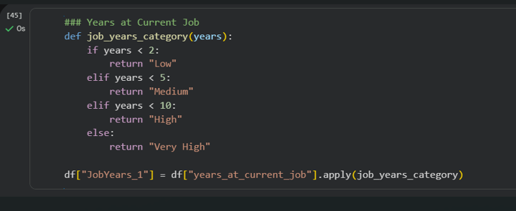
05 OUTLIER HANDLING
7
Debt-to-Income Ratio: Risk Banding
The selected notebook step converts DTI values into interpretable risk levels.
Low
DTI < 0.20
Medium
0.20 ≤ DTI < 0.36
DTI thresholds used in the notebook
High
0.36 ≤ DTI < 0.50
• A higher DTI indicates a larger proportion of income committed to debt obligations.
• The categorical DTI feature makes risk communication simpler and supports later modeling.
Very High
DTI ≥ 0.50

Slide 7
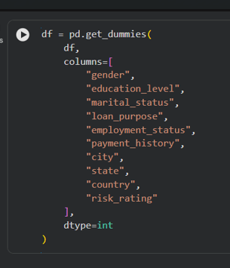
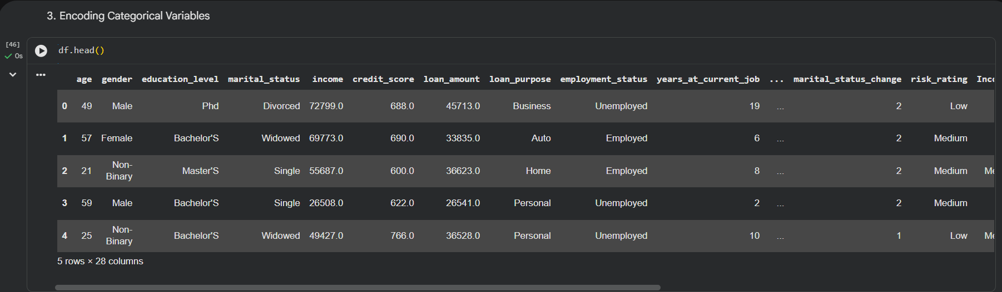
06 CATEGORICAL ENCODING
8
Encoding Categorical Variables
Text-based financial attributes are converted into numerical representations for machine learning.
pd.get_dummies() applied to categorical columns
pd.get_dummies() is used to encode categorical features.
Features such as gender, education level, marital status, loan purpose, employment status, payment history, location, and risk rating are encoded.
Each category is converted into binary (0/1) indicator columns.
This transformation makes categorical data suitable for machine learning and financial risk prediction.

Slide 8
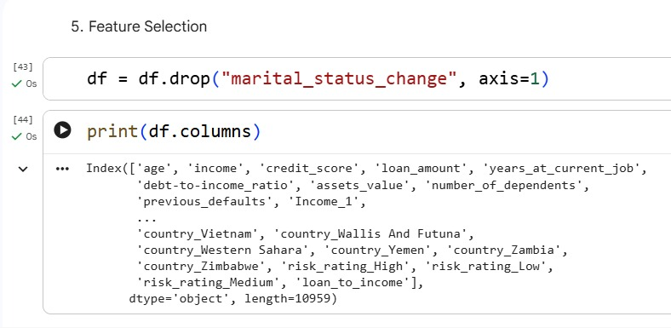
07 FEATURE SELECTION
9
Feature Selection & Dataset Simplification
Irrelevant or redundant fields are removed to create a cleaner modeling dataset.
Example removal
df.drop("marital_status_change", axis=1)
Result
The remaining columns focus on useful financial, demographic and risk indicators.
marital_status_change removed before modeling
• Removing unnecessary variables reduces noise and unnecessary model complexity.
• The resulting feature set includes age, income, credit score, loan amount, DTI, assets, dependents, previous defaults and engineered risk features.
• Feature selection helps improve interpretability and can support more efficient modeling.

Slide 9
08 END-TO-END PIPELINE
10
Financial Risk Analysis Pipeline
The screenshots demonstrate a complete preprocessing flow from raw records to model-ready risk features.
Inspect
Understand rows, columns, missing values and data types.
Clean
Handle missing values and standardize numeric fields.
Categorize
Create income, credit, loan, DTI and profile risk bands.
Encode
Convert categorical variables into numerical features.
Select
Remove unnecessary fields and retain relevant predictors.
1
2
3
4
5
• This sequence produces a structured dataset that can be used for risk profiling, visualization and predictive modeling.

Slide 10
09 CONCLUSION
11
Key Outcomes
The preprocessing stage transforms raw financial records into meaningful risk information.
• Validated the dataset structure and identified numeric and categorical fields.
• Standardized integer and floating-point columns for reliable analysis.
• Created interpretable risk categories for income, credit score, loan amount, DTI, previous defaults, age and job tenure.
• Encoded categorical variables into numerical features.
• Removed an unnecessary variable and retained a focused set of financial risk predictors.
Clean Data
Consistent types and structured variables.
Meaningful Risk Features
Risk bands make financial behavior easier to interpret.
Model-Ready Dataset
Encoded and selected features support further analysis.

Slide 11
THANK YOU
Financial Risk Analysis
Questions & Discussion
LOW
MEDIUM
HIGH

